Slide 1
16S rRNA sequence processing

Slide 2
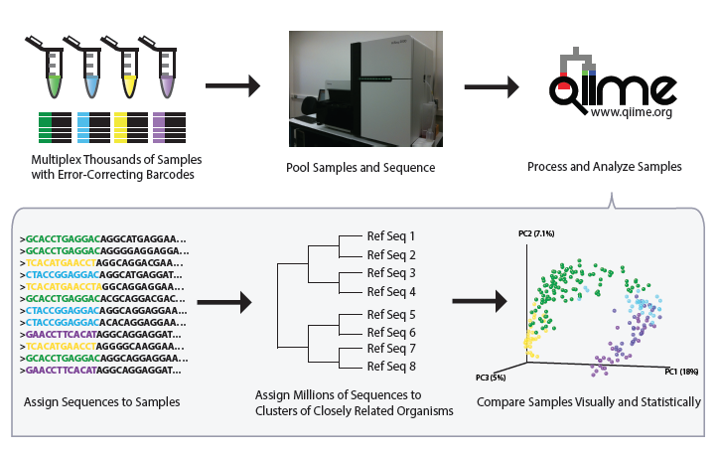

Slide 4
http://www.earthmicrobiome.org/emp-standard-protocols/
Original 515f construct / modified construct (Jed Furhman, C to Y base change on the 5’ end)
5'-GTGCCAGCMGCCGCGGTAA-3' / 5'-GTGYCAGCMGCCGCGGTAA-3'
Original 806r construct / modified construct (Amy Apprill, H to N base change mid-primer):
5'-GGACTACHVGGGTWTCTAAT-3' / 5’-GGACTACNVGGGTWTCTAAT-3’

Slide 5
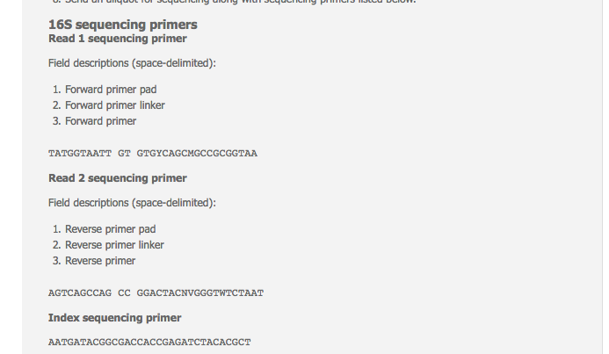
http://www.earthmicrobiome.org/emp-standard-protocols/
Notes:
10-nt pad to prevent hairpin formation, a 2-nt linker that is noncomplementary to the 16S rRNA gene, and a gene-specific primer.

Slide 6
Sequencing primer
Barcode
Primer pad
Linker
515f
AATGATACGGCGACCACCGAGATCTACACGCT XXXXXXXXXXXX TATGGTAATT GT GTGYCAGCMGCCGCGGTAA
Plate Name(s) | Plate Number | Well Position |  | Sequence | Barcode
IL_515fBC_Jed_Arch_1 | Plate 1 | A1 |  | AATGATACGGCGACCACCGAGATCTACACGCTAGCCTTCGTCGCTATGGTAATTGTGTGYCAGCMGCCGCGGTAA | AGCCTTCGTCGC
IL_515fBC_Jed_Arch_1 | Plate 1 | A2 |  | AATGATACGGCGACCACCGAGATCTACACGCTTCCATACCGGAATATGGTAATTGTGTGYCAGCMGCCGCGGTAA | TCCATACCGGAA
IL_515fBC_Jed_Arch_1 | Plate 1 | A3 |  | AATGATACGGCGACCACCGAGATCTACACGCTAGCCCTGCTACATATGGTAATTGTGTGYCAGCMGCCGCGGTAA | AGCCCTGCTACA
IL_515fBC_Jed_Arch_1 | Plate 1 | A4 |  | AATGATACGGCGACCACCGAGATCTACACGCTCCTAACGGTCCATATGGTAATTGTGTGYCAGCMGCCGCGGTAA | CCTAACGGTCCA
IL_515fBC_Jed_Arch_1 | Plate 1 | A5 |  | AATGATACGGCGACCACCGAGATCTACACGCTCGCGCCTTAAACTATGGTAATTGTGTGYCAGCMGCCGCGGTAA | CGCGCCTTAAAC
IL_515fBC_Jed_Arch_1 | Plate 1 | A6 |  | AATGATACGGCGACCACCGAGATCTACACGCTTATGGTACCCAGTATGGTAATTGTGTGYCAGCMGCCGCGGTAA | TATGGTACCCAG
IL_515fBC_Jed_Arch_1 | Plate 1 | A7 |  | AATGATACGGCGACCACCGAGATCTACACGCTTACAATATCTGTTATGGTAATTGTGTGYCAGCMGCCGCGGTAA | TACAATATCTGT
IL_515fBC_Jed_Arch_1 | Plate 1 | A8 |  | AATGATACGGCGACCACCGAGATCTACACGCTAATTTAGGTAGGTATGGTAATTGTGTGYCAGCMGCCGCGGTAA | AATTTAGGTAGG
IL_515fBC_Jed_Arch_1 | Plate 1 | A9 |  | AATGATACGGCGACCACCGAGATCTACACGCTGACTCAACCAGTTATGGTAATTGTGTGYCAGCMGCCGCGGTAA | GACTCAACCAGT
IL_515fBC_Jed_Arch_1 | Plate 1 | A10 |  | AATGATACGGCGACCACCGAGATCTACACGCTGCCTCTACGTCGTATGGTAATTGTGTGYCAGCMGCCGCGGTAA | GCCTCTACGTCG

Slide 7
Sequencing primer
Barcode
Primer pad
Linker
515f
AATGATACGGCGACCACCGAGATCTACACGCT XXXXXXXXXXXX TATGGTAATT GT GTGYCAGCMGCCGCGGTAA
Plate Name(s) | Plate Number | Well Position |  | Sequence | Barcode
IL_515fBC_Jed_Arch_1 | Plate 1 | A1 |  | AATGATACGGCGACCACCGAGATCTACACGCTAGCCTTCGTCGCTATGGTAATTGTGTGYCAGCMGCCGCGGTAA | AGCCTTCGTCGC
IL_515fBC_Jed_Arch_1 | Plate 1 | A2 |  | AATGATACGGCGACCACCGAGATCTACACGCTTCCATACCGGAATATGGTAATTGTGTGYCAGCMGCCGCGGTAA | TCCATACCGGAA
IL_515fBC_Jed_Arch_1 | Plate 1 | A3 |  | AATGATACGGCGACCACCGAGATCTACACGCTAGCCCTGCTACATATGGTAATTGTGTGYCAGCMGCCGCGGTAA | AGCCCTGCTACA
IL_515fBC_Jed_Arch_1 | Plate 1 | A4 |  | AATGATACGGCGACCACCGAGATCTACACGCTCCTAACGGTCCATATGGTAATTGTGTGYCAGCMGCCGCGGTAA | CCTAACGGTCCA
IL_515fBC_Jed_Arch_1 | Plate 1 | A5 |  | AATGATACGGCGACCACCGAGATCTACACGCTCGCGCCTTAAACTATGGTAATTGTGTGYCAGCMGCCGCGGTAA | CGCGCCTTAAAC
IL_515fBC_Jed_Arch_1 | Plate 1 | A6 |  | AATGATACGGCGACCACCGAGATCTACACGCTTATGGTACCCAGTATGGTAATTGTGTGYCAGCMGCCGCGGTAA | TATGGTACCCAG
IL_515fBC_Jed_Arch_1 | Plate 1 | A7 |  | AATGATACGGCGACCACCGAGATCTACACGCTTACAATATCTGTTATGGTAATTGTGTGYCAGCMGCCGCGGTAA | TACAATATCTGT
IL_515fBC_Jed_Arch_1 | Plate 1 | A8 |  | AATGATACGGCGACCACCGAGATCTACACGCTAATTTAGGTAGGTATGGTAATTGTGTGYCAGCMGCCGCGGTAA | AATTTAGGTAGG
IL_515fBC_Jed_Arch_1 | Plate 1 | A9 |  | AATGATACGGCGACCACCGAGATCTACACGCTGACTCAACCAGTTATGGTAATTGTGTGYCAGCMGCCGCGGTAA | GACTCAACCAGT
IL_515fBC_Jed_Arch_1 | Plate 1 | A10 |  | AATGATACGGCGACCACCGAGATCTACACGCTGCCTCTACGTCGTATGGTAATTGTGTGYCAGCMGCCGCGGTAA | GCCTCTACGTCG

Slide 9
Extracting barcodes for your index fastq file
extract_barcodes.py

Slide 10
Demultiplexing
echo "split_libraries_fastq.py -m /home/metcalfj/PROJECTS/Trace_Evidence/May2016/10682_prep_2055_qiime_20160818-215702.txt -o /home/metcalfj/PROJECTS/Trace_Evidence/May2016/split -i /sequencing/ucsd/complete_runs/160810_M00436_0185_000000000-AMW65/Metcalf_TE2_May_9-10_S1_L001_R1_001.fastq.gz -b /sequencing/ucsd/complete_runs/160810_M00436_0185_000000000-AMW65/Metcalf_TE2_May_9-10_S1_L001_I1_001.fastq.gz --rev_comp_mapping_barcodes --rev_comp_barcode" | qsub -k eo -N split.lib -l walltime=48:00:00 -l pmem=8gb -V

Slide 11
Working with already-demultiplexed fastq files
http://qiime.org/tutorials/processing_illumina_data.html

Slide 12
OTU picking
OTU picking approach
Closed reference (must hit a database sequence)
De novo (clustering, not database)
Open reference (use database, then denovo for sequences not hitting database)
Database choice (need for OTU picking and taxonomy assignment)
Greengenes
Silva

Slide 14
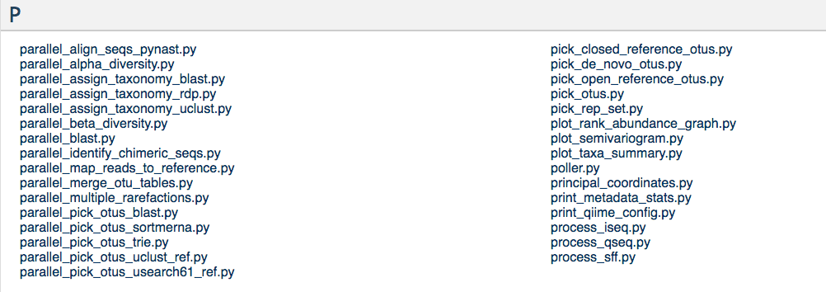
OTU clustering algorithms
Algorithms – SortmeRNA, SUMACLUST, swarm, uclust (default), usearch
QIIME 1.9 SortMeRNA for closed-reference steps, and swarm and SumaClust for de novo steps
pick_open_reference_otus.py -m sortmerna_sumaclust

Slide 15
Pros/cons OTU picking
Closed
Pros
Computationally quick
Best 16S tree
Ref database is a quality filter
Meta analysis easier
Cons
Reference database bias
New OTUs may be excluded
Denovo
Pros
New OTUs may be included
Cons
Computationally $$
Erroneous sequences included
Denovo tree not as good
Need to repick OTUs every time you add data

Slide 16
Taxonomy assignment
Assignment methods - BLAST, the RDP classifier, RTAX, mothur, and uclust (default)
Reference databases – greengenes, Silva, or make your own!

Slide 17
Goal: get an OTU Table with taxonomy!
Next week
1) filtering out Chloroplast, etc
2) minimum number of reads in a sample?
2) rarifying vs normalizing

